Slide 1
Biological Safety Cabinet
Biosafety cabinets are intended to protect a laboratory worker from aerosols and airborne particles.
Aerosol particles of less than 5 µm in diameter and small droplets of 5–100 µm in diameter are not visible to the naked eye.
The laboratory worker is generally not aware that such particles are being generated and may be inhaled or may cross contaminate work surface materials.
BSCs, when properly used, have been shown to be highly effective in reducing laboratory- acquired infections. BSCs also protect the environment.
Most BSCs use high efficiency particulate air (HEPA) filters in the exhaust and supply systems.
The exception is a Class I BSC, which does not have HEPA filtered supply air.

Slide 2
The HEPA filter traps 99.97% of particles of 0.3 µm in diameter and 99.99% of particles of greater or smaller size.
This enables the HEPA filter to effectively trap all known infectious agents and ensure that only microbe-free exhaust air is discharged from the cabinet.
Types of Biosafety cabintes
There are three kinds of safety cabinet,
Classes I, II, and III.
Class I and Class II cabinets are used in diagnostic and containment laboratories for work with Risk Group 3 organisms.
Class III cabinets are used almost exclusively for Risk Group 4 organisms.

Slide 3
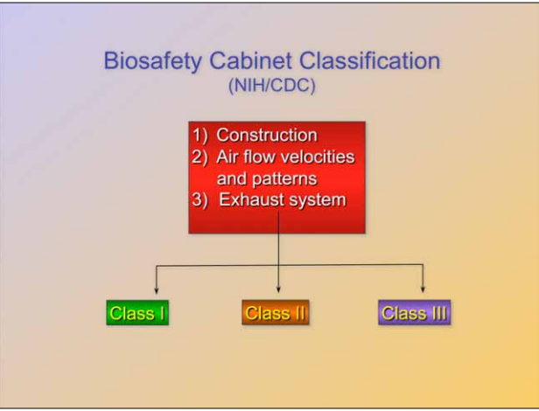

Slide 4
1.Class I safety cabinet:
It has a front opening.
The operator sits at the cabinet, looks through the glass screen, and works with the hands inside.
Any aerosols released from cultures or other infectious materials are retained because a current of air passes in at the front of the cabinet and sweeps the aerosols up through a HEPA filter which removes all or most of the organisms.
Clean air then passes through the fan, which maintains the air flow, and is exhausted (discharged) to atmosphere where any particles or organisms that have not been retained on the filter are so diluted that they are no longer likely to cause infection if inhaled.

Slide 5
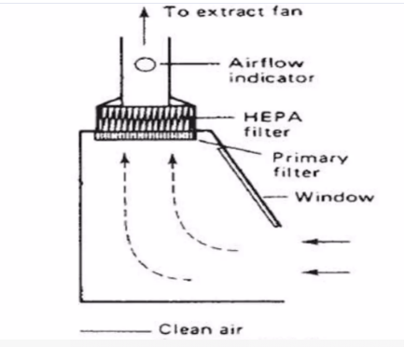

Fig: Class I safety cabinet

Slide 6
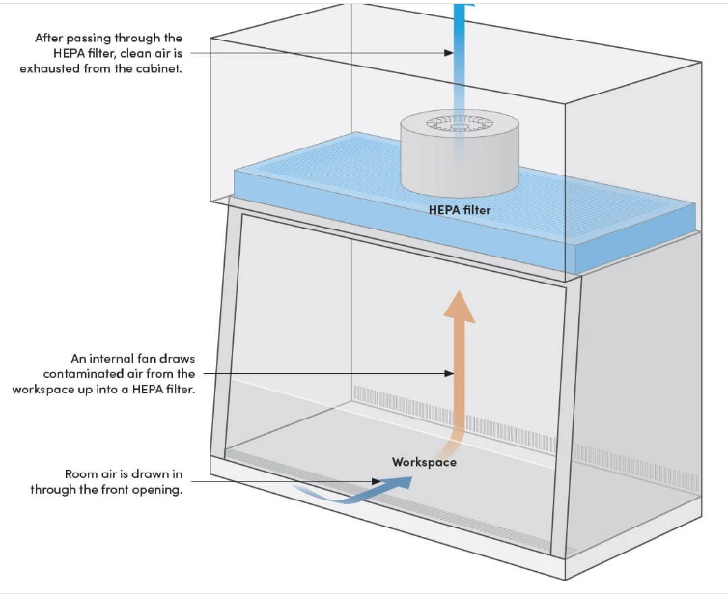

Slide 7
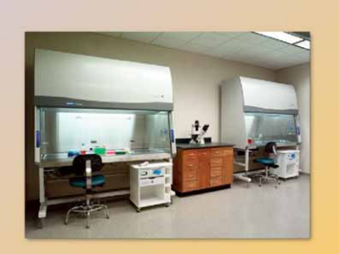

Slide 8
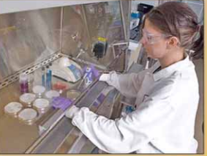

Slide 9
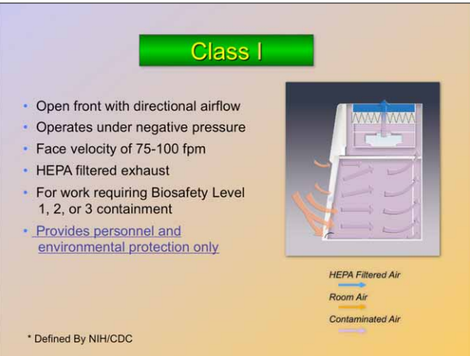

Slide 10
2.Class II safety cabinet:
In a Class II cabinet about 70% of the air is recirculated through filters so that the working area is bathed in clean (almost sterile) air.
The air flow carries along any aerosols produced in the course of the work and these are removed by the filters.
Some of the air (about 30%) is exhausted to atmosphere and is replaced by a ‘curtain’ of room air which enters at the working face.
This prevents the escape of any particles or aerosols released in the cabinet.

Slide 11
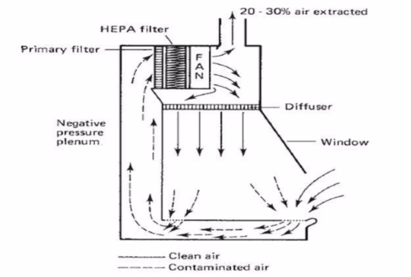
Fig: Class II safety cabinet

Slide 12
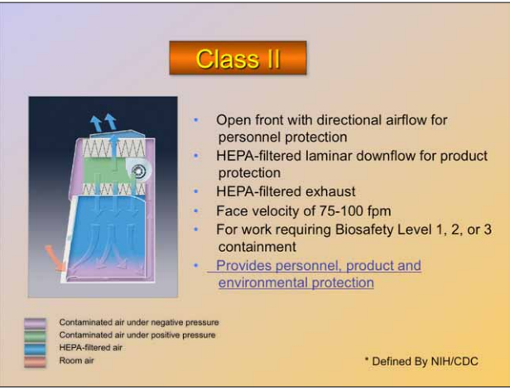

Slide 13
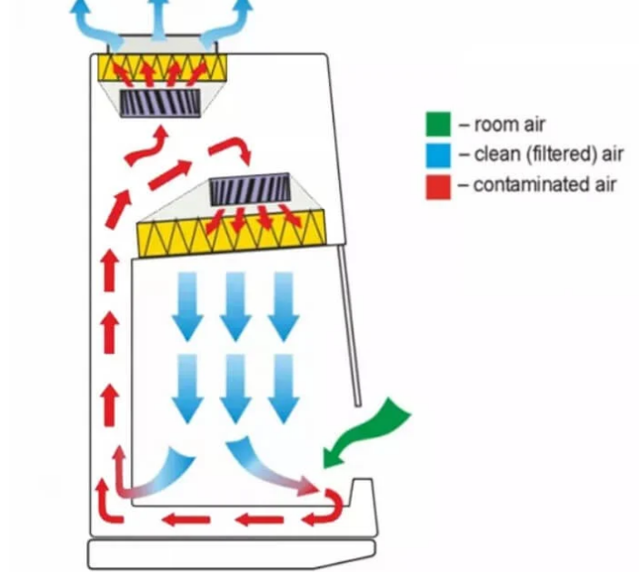

Slide 14
The three main features are: CLASS 2
Product protection with downward HEPA-filtered unidirectional/laminar airflow
Open front with careful regulated inward airflow for personnel protection
HEPA-filtered exhaust air is directed toward a room or a facility exhaust system for environmental protection.

Slide 15
3.Class III safety cabinet: for Risk Group 4 viruses
This type provides the highest level of personnel protection and is used for Risk Group 4 agents.
This type of cabinet is totally enclosed and is tested under pressure to ensure that no particles can leak from it into the room. The operator works with gloves which form part of the cabinet.
Air enters through a filter and is exhausted to atmosphere through one or two more filters.
The Class III cabinet may be connected to a double-door autoclave used to decontaminate all materials entering or exiting the cabinet.
Several glove boxes can be joined together to extend the work surface.
Class III BSCs are suitable for work in Biosafety Level 3 and 4 laboratories.

Slide 16
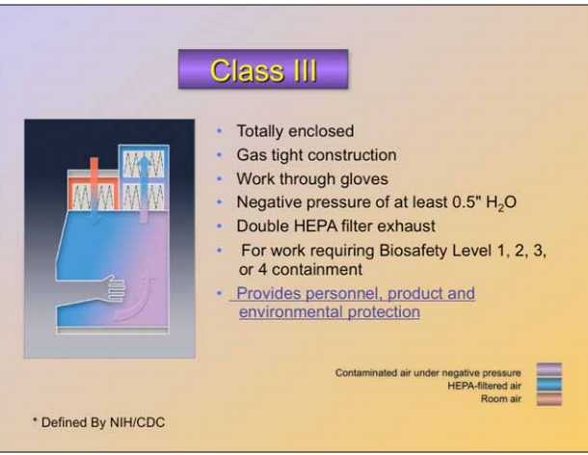

Slide 17
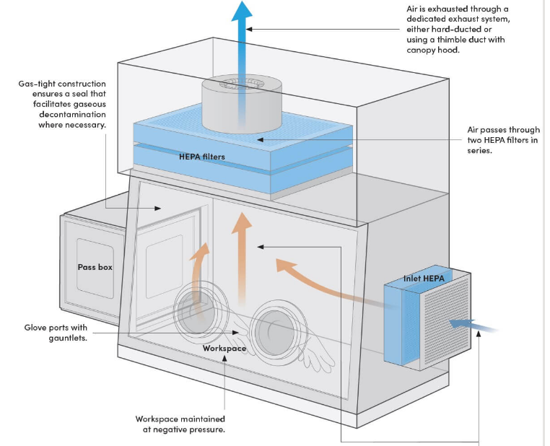

Slide 18
Use of safety cabinets
A safety cabinet should not be loaded with unnecessary equipment or it will not carry out its job properly.
Work should be done in the middle to rear of the cabinet, not near the front.The operator should avoid bringing the hands and arms out of the cabinet while working. After each set of manipulations and before withdrawing the hands, the operator should wait for 2–3 minutes to allow any aerosols to be swept into the filters.
After finishing work in a safety cabinet, the hands and arms may be contaminated and should be washed immediately.
14. Sitting and maintenance of a safety cabinet
The efficient working of a safety cabinet depends on its correct sitting and proper maintenance.
The manufacturer’s instruction manual must be studied carefully.
Safety cabinets should be swabbed out with a suitable disinfectant after use and regularly decontaminated with formaldehyde.
Decontamination is essential before the filters are changed.

Slide 19
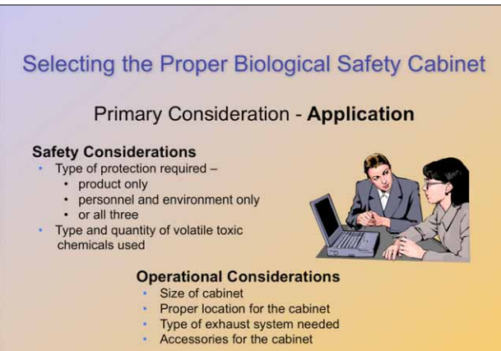

Slide 20
